Slide 1
On Socially Fair Low-Rank Approximation and Column Subset Selection
Zhao Song
Ali Vakilian
David P. Woodruff
Samson Zhou

Slide 2


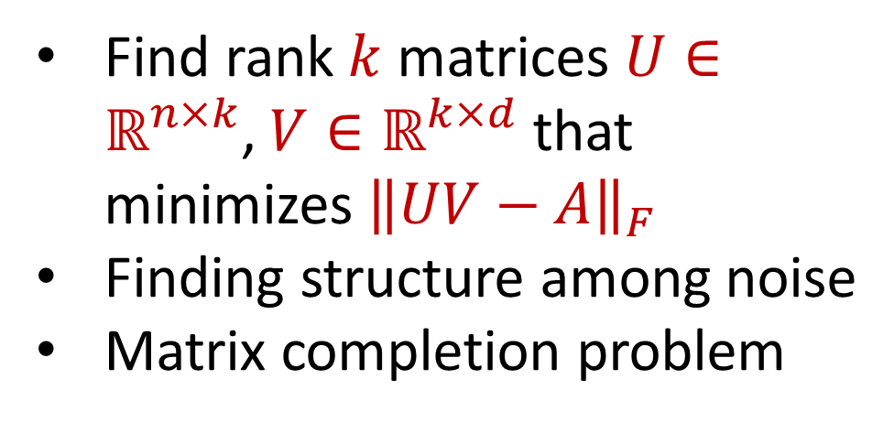

Low-Rank Approximation
1 3 5 -2 7 0 11 4 -8
0 0 -1 3 13 2 8 6 2
2 5 6 1 4 0 -7 5 3
8 7 2 1 -1 -3 -2 -4 -6
-5 3 -4 -1 -2 -1 0 -3 -1
7 1 3 2 4 1 0 11 1
Find rank $k$ matrices $U∈ℝ^{n×k}$, $V∈ℝ^{k×d}$ that minimizes ${\left\|UV−A\right\|}_{F}$
Finding structure among noise
Matrix completion problem
$$n$$
$$d$$

Slide 3
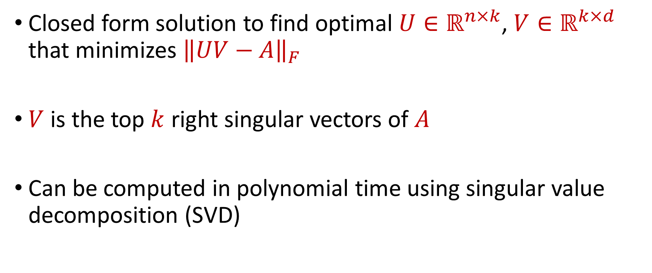
Low-Rank Approximation
Closed form solution to find optimal $U∈ℝ^{n×k}$, $V∈ℝ^{k×d}$ that minimizes ${\left\|UV−A\right\|}_{F}$
$V$ is the top $k$ right singular vectors of $A$
Can be computed in polynomial time using singular value decomposition (SVD)

Slide 4


Column Subset Selection
1 3 5 -2 7 0 11 4 -8
0 0 -1 3 13 2 8 6 2
2 5 6 1 4 0 -7 5 3
8 7 2 1 -1 -3 -2 -4 -6
-5 3 -4 -1 -2 -1 0 -3 -1
7 1 3 2 4 1 0 11 1
Find matrices $U∈ℝ^{n×k}$, $V∈ℝ^{k×d}$ that minimizes ${\left\|UV−A\right\|}_{F}$, where $V$ is $k$ columns of $A$
Finding structure among noise
Low-rank approximation variant with better interpretability
$$n$$
$$A$$
$$d$$

Slide 5
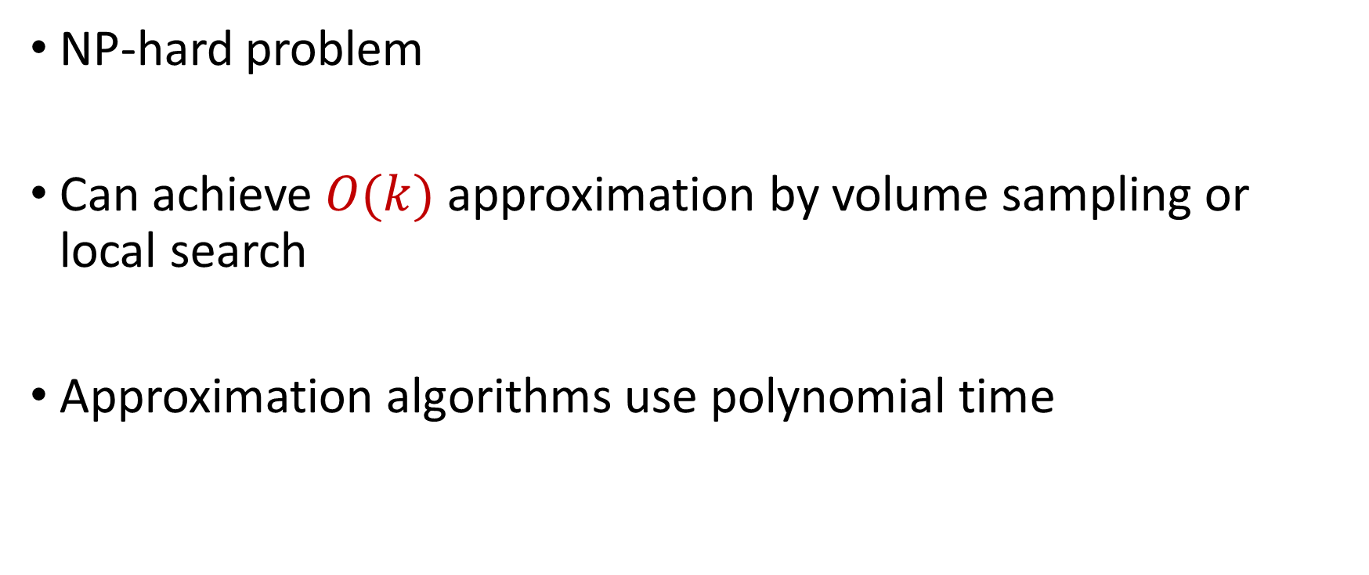
Column Subset Selection
NP-hard problem
Can achieve $O(k)$ approximation by volume sampling or local search
Approximation algorithms use polynomial time

Slide 6



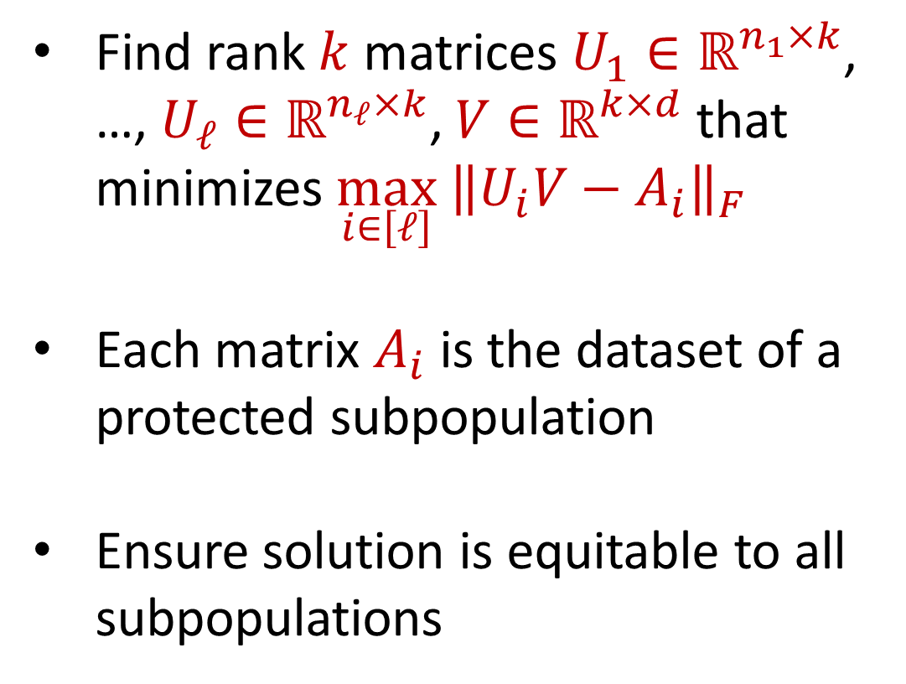





Social Fairness
1 3 5 -2 7 0 11 4 -8
0 0 -1 3 13 2 8 6 2
Find rank $k$ matrices $U_{1}∈ℝ^{n_{1}×k}$, …, $U_{ℓ}∈ℝ^{n_{ℓ}×k}$, $V∈ℝ^{k×d}$ that minimizes $\max_{i∈\left[ℓ\right]}{ \left\|U_{i}V−A_{i}\right\|}_{F}$
Each matrix $A_{i}$ is the dataset of a protected subpopulation
Ensure solution is equitable to all subpopulations
$$n_{1}$$
$$A_{1}$$
$$d$$
2 5 6 1 4 0 -7 5 3
8 7 2 1 -1 -3 -2 -4 -6
-5 3 -4 -1 -2 -1 0 -3 -1
$$n_{2}$$
$$⋮$$
$$A_{2}$$
$$n_{ℓ}$$
7 1 3 2 4 1 0 11 1
$$A_{ℓ}$$

Slide 7
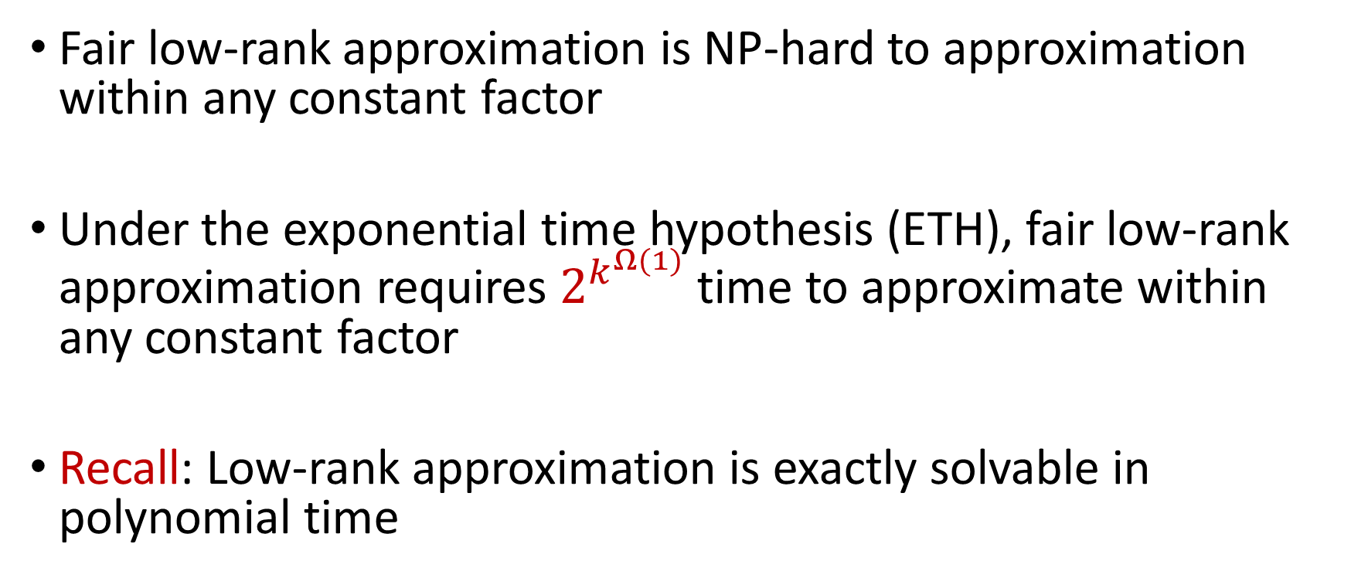
Our Results
Fair low-rank approximation is NP-hard to approximation within any constant factor
Under the exponential time hypothesis (ETH), fair low-rank approximation requires $2^{k^{Ω(1)}}$ time to approximate within any constant factor
Recall: Low-rank approximation is exactly solvable in polynomial time

Slide 8
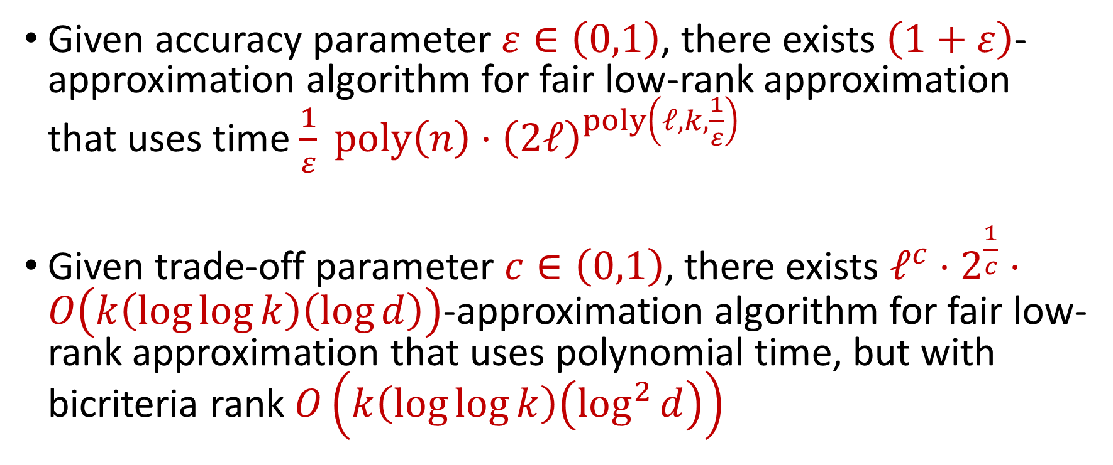
Our Results (II)
Given accuracy parameter $ε∈\left(0,1\right)$, there exists $\left(1+ε\right)$-approximation algorithm for fair low-rank approximation that uses time $\frac{1}{ε} poly\left(n\right)⋅{\left(2ℓ\right)}^{poly\left(ℓ,k,\frac{1}{ε}\right)}$
Given trade-off parameter $c∈\left(0,1\right)$, there exists $ℓ^{c}⋅2^{\frac{1}{c}}⋅O\left(k\left(\log{\log{k}}\right)\left(\log{d}\right)\right)$-approximation algorithm for fair low-rank approximation that uses polynomial time, but with bicriteria rank $O\left(k\left(\log{\log{k}}\right)\left(\log^{2}{d}\right)\right)$

Slide 9

Our Results (III)
There exists $O\left(k\left(\log{\log{k}}\right)\left(\log{d}\right)\right)$-approximation algorithm for fair column subset selection that uses polynomial time, but with bicriteria rank $O\left(k\log{k}\right)$

